Slide 1
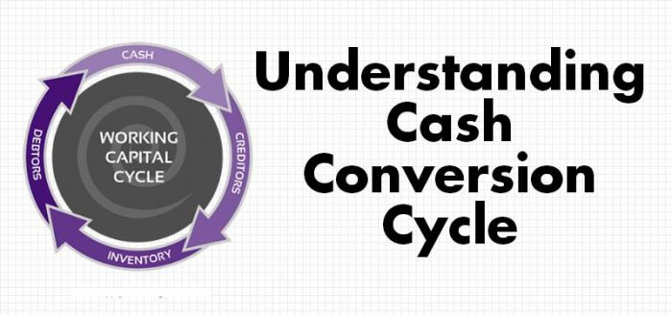

Slide 2
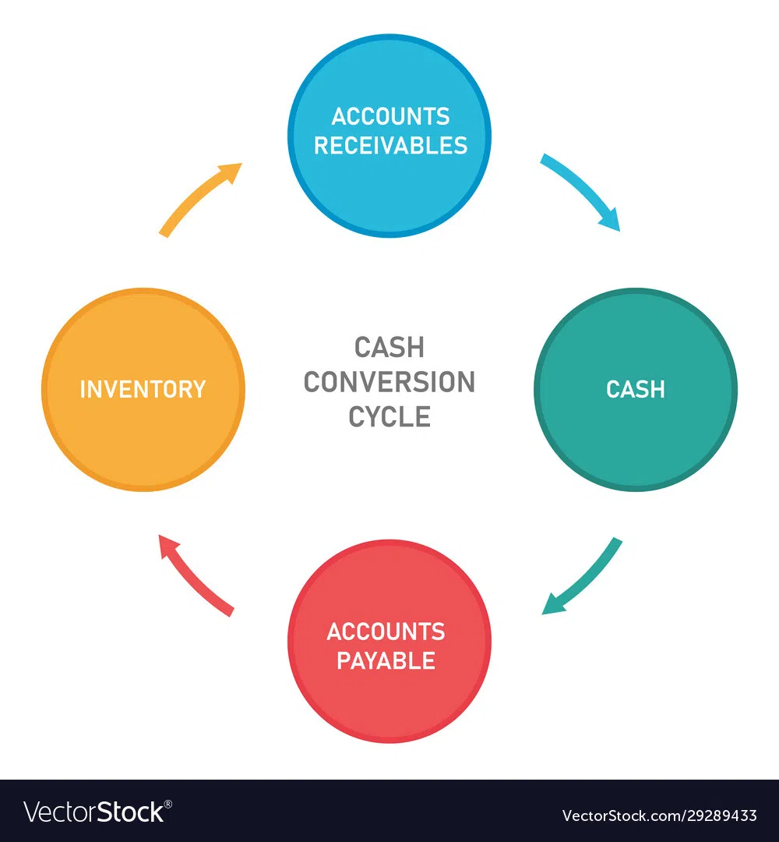

Slide 3
Operating Cycle
The duration of time required to complete the sequence of events right from purchase of raw material / goods for cash to the realization of sales in cash is called the operating cycle, working capital cycle or cash cycle. In a manufacturing company, the operating cycle is the length of time required to complete a series of events described as follows:
Conversion of cash into raw materials.
Conversion of raw materials into work-in-progress.
Conversion of work-in-progress into finished goods.
Conversion of finished goods into accounts receivable.
Conversion of accounts receivable into cash.

Slide 4
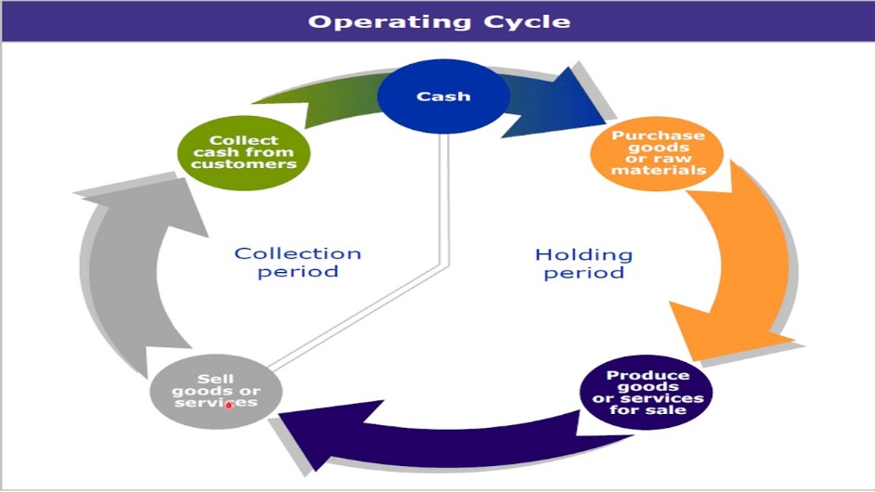

Slide 5
